Slide 1
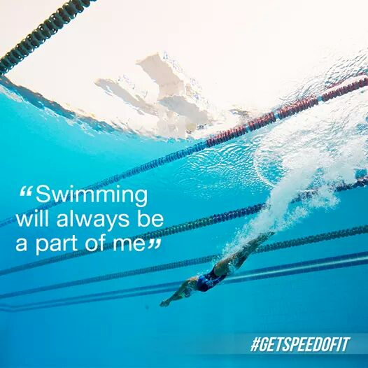
BASIC SWIMMING

Slide 2
BASIC SWIMMING
COURSE OBJECTIVES
To build confidence in aquatics (swimming)
To develop and build propulsion skills (arm and leg movement)
To know and appreciate the sport of swimming
To be introduced to the basics in water safety and rescue

Slide 3
BASIC SWIMMING
COURSE CONTENT
Aquatic acclimatization; entry/exit, walking, bubbling, breathe-holding, gliding, body balance.
Propulsion; leg movement, arm movement, arm-leg movement, air exchange, full stroke (breaststroke)
Development of swimming; swimming and society, benefits of swimming, Improving swimming in Ghana
Swimming and Rescue; basics of aquatic rescue, preventing accidents (lifeguarding), and managing casualty at the pool/beach scene.

Slide 4
BASIC SWIMMING
INSTRUCTORS
DANIEL AFRIFA, 0248793527
ANTHONY ASMOAH-MENSAH, 0540841594
ISAAC GYAMFI, 0208978958

Slide 5
SWIMMING
Swimming is an individual or team sport that involve using the arms and legs to move the body through water.
Swimming takes place in pools or in open water (sea, lakes, rivers etc)
Competitive swimming is one of the most popular sports in the Olympics games
There are four (4) major strokes in swimming; butterfly, backstrokes, freestyle and breaststroke.
World championship pools must be 50 meters long and 25 meters wide with ten labels labelled zero (0) to nine (9) or one (1) to ten (10) with the lanes at least 2.5 meters wide

Slide 6
SWIMMING
In competitive swimming, there are several types of officials needed to manage the competition;
Referee
Starter
Clerk of course (Bull pen)
Timekeepers
Inspectors of turns
Judges of stroke
Finish judges

Slide 7
DEVELOPMENT OF SWIMMING
Evidence of swimming in prehistoric times dated back to stone age paintings around 10000 years ago near wadi sora (sura) in the south western part of Egypt.
Written reference was found in stories like the Iliad, odyssey, the bible (Ezekiel 47:5, Acts 27:42, Isaiah 25:11), Beowulf, the Quran
The first swimming book published by a German Professor, Nikolaus Wynmann in 1538 (the swimmer or a dialogue on the art of swimming)
Competitive swimming emerged in recreational pool centres in London, England in 1830s

Slide 8
DEVELOPMENT OF SWIMMING
International Federation on swimming, FINA(Federation international de natation) was formed in 1908
Men’s swimming became part of the Olympics in 1896
Competitions in aquatics include swimming, synchronised swimming, diving, open water competitions, water polo and lifesaving competitions
Celebrated swim athletes include Michael Phelps and Adams Peaty

Slide 9
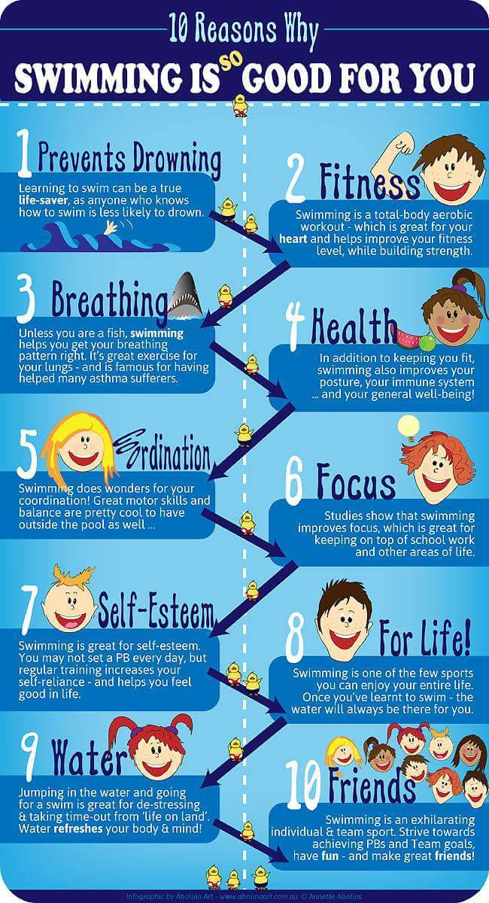
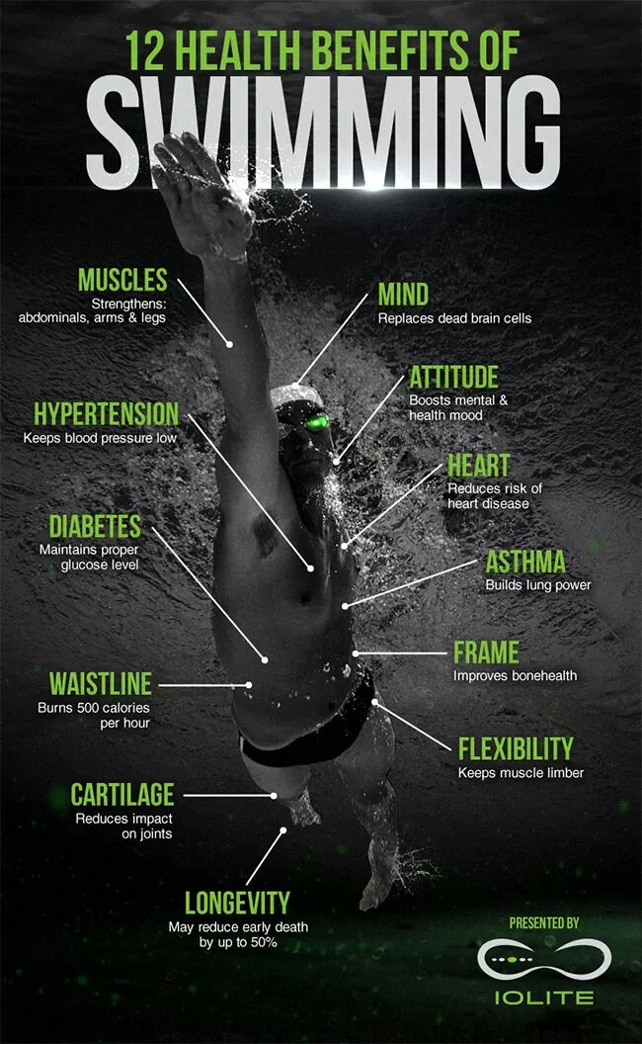
DEVELOPMENT OF SWIMMING
BENEFITS OF SWIMMING

Slide 10
SAFETY IN AND AROUND THE POOL
A respect for the water and an understanding of associated dangers are necessary for safety just about everywhere.
General rules and routines should be borne in mind at all times.
Swimming pool users should be aware of water depths indicated on the pool sides.
There should be no running on the poolside; wet floors can be slippery and consequent falls can cause injury.
Swim hats should be worn by those with long hair, or the hair should be tied securely so that it cannot cover the face and especially the mouth.

Slide 11
SAFETY IN AND AROUND THE POOL
Sweets or chewing gum should be avoided. It is dangerous to enter the water with these in the mouth.
Jewellery should not be worn. It can be dangerous if the wearer is in close contact with other people in the water.
After a meal, food should be allowed to digest for at least 1.5 hours.
If goggles are worn they should fit snugly and should be constructed of safe material.

Slide 12
SAFETY IN AND AROUND THE POOL
Floats and other buoyancy aids should be treated with care and not thrown about. Inflatable aids should be checked frequently for damage or malfunction. Beginners using them should remain in a safe depth of water.
Care must be taken when diving to ensure that the entry area is clear of swimmers and obstructions and that the water is sufficiently deep.
Diving entries for swimming should be of the plunge style.
They should be shallow dives performed from a firm stance into a clear area of water.
For early practices the depth of water should be at least 1.8 metres.

Slide 13
SAFETY IN AND AROUND THE POOL
Only after proficiency has been gained can special racing type entries, as required by competitive swimmers, be made into shallower water, determined by the depth of water at the starting end of the pool and never less than 1.5m deep.
Diving as a sporting form and used in competition requires special training which usually takes place in diving clubs.
Entries are made from purpose-built platforms and springboards with the body in a vertical position requiring a water depth of up to 5 metres.
Those responsible for the use of the pool should be familiar with the Normal Operating Procedure and the Emergency Action Plan which all pool operators are required to have in place.

Slide 14
SAFETY IN AND AROUND THE POOL
Swimming in Open Water
Not all swimming takes place in the comparatively safe environment of a swimming pool and there are many water activities for which swimming should be a prerequisite.
For those who use open water the following safety code should be observed:
DO NOT swim alone unless competent help is at hand.
DO NOT bathe in areas where red flags or other warnings are displayed.
DO NOT fool about at the sides of rivers, lakes, canals or quays.

Slide 15
SAFETY IN AND AROUND THE POOL
DO NOT venture on frozen ponds.
DO NOT float out to sea on inflatables; tides can be treacherous even for strong swimmers.
DO NOT go out in small boats without wearing a life-jacket and telling somebody where you are going and when you are due back.
Follow the Water Safety Code:
Spot the dangers
Take safety advice
Don’t go alone
Learn how to help

Slide 16
SAFETY IN AND AROUND THE POOL
Always wear footwear to prevent injury, discarding it only when swimming.
Wear a brightly coloured swim hat to retain body heat and so you can be easily seen.
Have shelter and first aid equipment available.

Slide 17
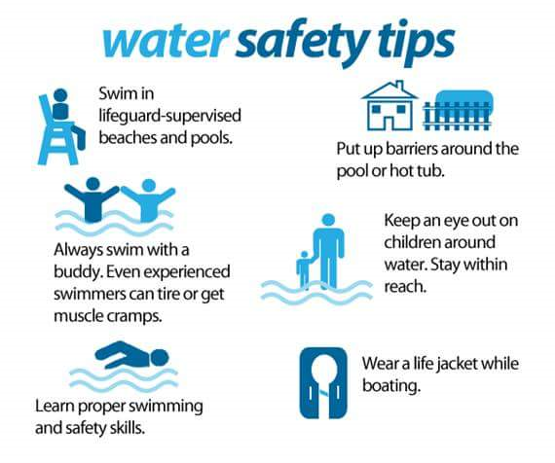
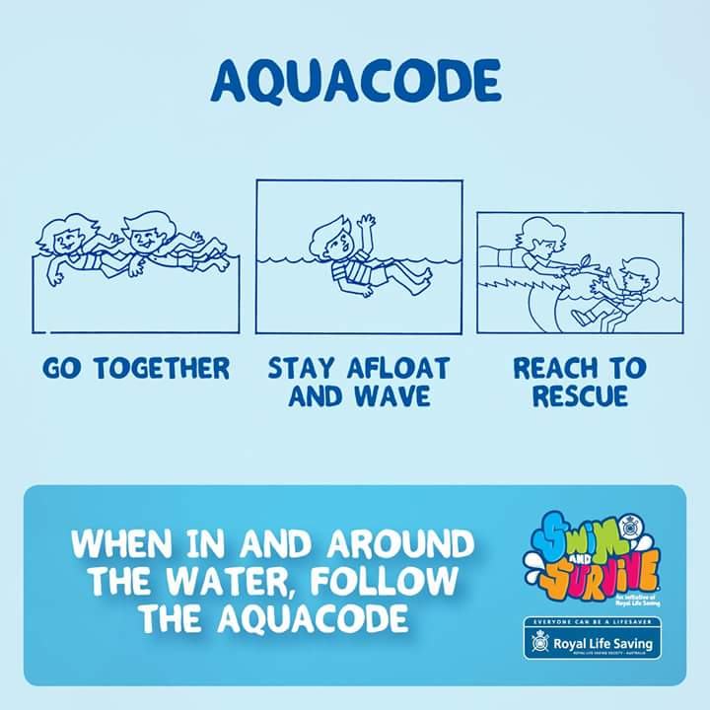

Slide 18
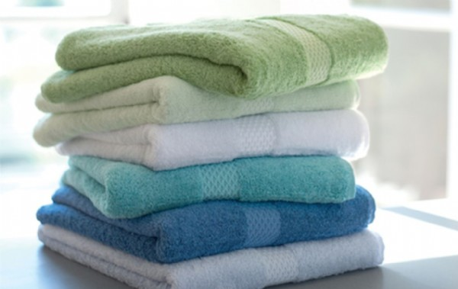
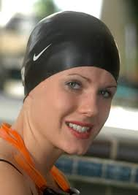
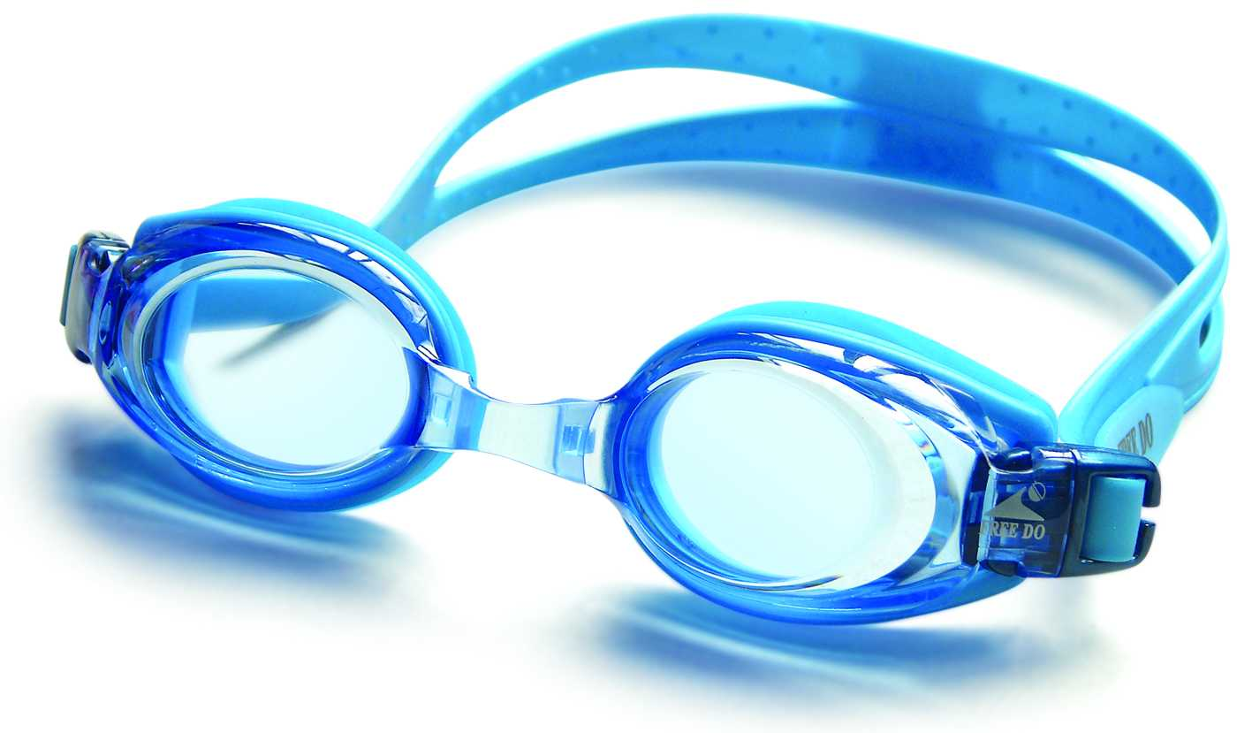
SAFETY IN AND AROUND THE POOL
Swim tool kits
You will want to feel comfortable wearing your swimwear from a personal point of view and also when in the water too.
If your items aren’t comfortable then this means you will be focussing on what you are wearing, as opposed to your swimming style.
Towel : Make sure you have a swimming towel with you when you go for lessons or to practice your technique in the water.

Slide 19
SAFETY IN AND AROUND THE POOL
It’s quite an awkward and embarrassing situation if you come out of the sea or the pool soaking wet, only to discover that you’ve left your towel at home.
It might be best to have a few towels so that you can alternate between the two on a frequent basis.
This will also be more hygienic, compared to using one towel over again.
Swim cap: To keep your hair protected from saturation and also from the damaging effects of chlorine, it’s worth buying a swim cap.

Slide 20
SAFETY IN AND AROUND THE POOL
This piece of swimwear will also keep the pool clean for other users and stop any filters getting clogged up.
In addition, you will also create a smoother profile in the water, reducing the amount of drag you create.
Goggles: Your sight is hugely important, so protect it from water debris and chlorine by purchasing a decent pair of goggles.
Find a pair that fit comfortably and that will allow you to see in the water when you are developing your technique.

Slide 21
SAFETY IN AND AROUND THE POOL
As goggles come in a range of styles, including polarised, mirrored and clear lensed, personal preference will also play a part in choosing the best design for you
Nose clips: To stop water getting up your nose and to help those who suffer from sinus problems, nose clips are ideal.
They are designed to rest on the bridge of your nose and clasp the nostrils shut – allowing you to focus solely on your swimming style.

Slide 22
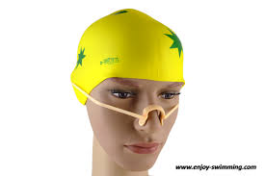
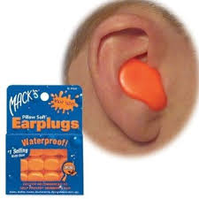
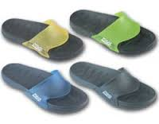
SAFETY IN AND AROUND THE POOL
Ear plugs: Nobody wants to get water in their ears when swimming, so purchase a decent pair of ear plugs.
These protective plugs are also great at preventing ear infections too and are designed to feel comfortable when placed in your ears.
They are also light and affordable, but will make the world of difference when in the pool.
Pool footwear: Walking barefoot around the swimming pool can be dangerous as surfaces are wet and slippery.
So give yourself additional support and grip and protect your feet from damage with some pool footwear.

Slide 23
SAFETY IN AND AROUND THE POOL
With footwear, you want to make sure that you buy the correct size.
If they are too small then they can cause damage to your feet, and if they are too big they are likely to fall off when walking to the water.
The right fit will offer you the right amount of grip and support

Slide 24
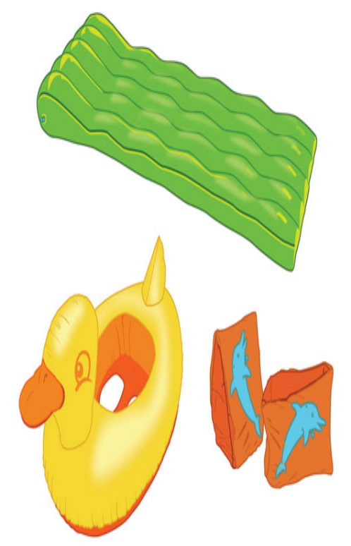
USING LIFE JACKETS
Life jackets, also known as personal flotation devices (PFDs), are not just for boaters.
Young children, weak or inexperienced swimmers and nonswimmers should also wear life jackets whenever they are in, on or around the water.
Life jackets are available in many styles and for many different activities. The U.S. Coast Guard has categorized PFDs into five types according to their buoyancy and purpose

Slide 25
USING LIFE JACKETS
Types I, II, III and V are referred to as life jackets because they are worn on the body, whereas type IV is a throwable device.
Water wings and items designed for water recreation (such as inner tubes and inflatable rafts) are not designed or tested for safety and cannot be used as a substitute for a U.S. Coast Guard approved life jacket and adult supervision

Slide 26
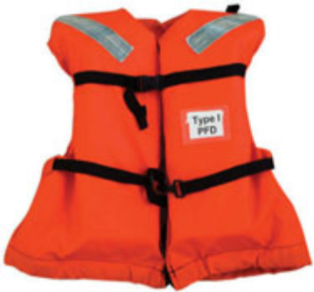
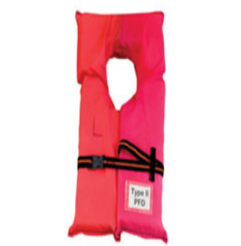
Life jacket:
Description: Intended for boating on open, rough or remote waters where rescue may be slowed or delayed. May help to turn an unconscious person from a face-down position to a vertical, face-up position or to a face-up slightly tipped back position
Advantages: Offers the most reliable flotation. It comes in highly visible colors and may have reflective markings to aid search and rescue
Disadvantages: Bulky in and out of the water
Buoyant vest
Description: Intended for recreational boating on calm or inland waters where rapid rescue is likely. Suitable for supervised use in pools and waterparks. May help to turn an unconscious person from a face-down position to a vertical, face-up position or to a face-up slightly tipped back position

Slide 27
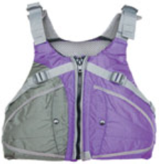
Advantages: More comfortable to wear. Available for infants through adults; good choice for children
Disadvantages: Not recommended for long hours on rough water. Less buoyant than a type I life jacket
Flotation Vest
Description: Intended for fishing or sailing on calm or inland waters where rapid rescue is likely. Suitable for supervised use in pools and waterparks. May help to keep a conscious person in a vertical, face-up position or in a face-up slightly tipped back position; wearer may have to tilt the head back to avoid going face-down
Advantages: Most comfortable to wear continuously. Available in many styles. Appropriate for boating and specified water activities

Slide 28

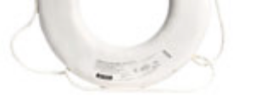
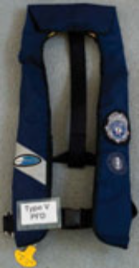
Disadvantages: Must be water tested by inexperienced swimmers before boating. Wearer may need to tilt head back to avoid turning face-down in the water
Throwable device
Description: Intended to be thrown to a person in the water; not to be worn Not intended to take the place of a wearable life jacket
Advantages: Able to be thrown from boat or land Backup to wearable life jackets. Possible use as seat cushions (some styles)
Disadvantages: Not suitable for children, inexperienced swimmers or unconscious victims

Slide 29
Special-use device
Description: Intended for specific activities such as whitewater rafting. May be worn instead of another life jacket only if used according to the approval condition(s) on its label. Worn continuously
Advantages: Designed for specific activities. Continuous wear provides continuous protection
Disadvantages: Limited use

Slide 30
SAFETY IN AND AROUND THE POOL
Swimming related conditions
Recreational Water Illness (RWI): is an illness that is spread by swallowing, breathing or contacting contaminated water.
A person can contract an RWI from a natural body of water or from the chlorinated water found in pools and waterpark attractions.
In fact, pool water is a very common source of RWIs, especially common ones such as diarrhea, earaches and rashes.
In rare cases, RWIs can cause pneumonia, neurological damage and even death.

Slide 31
SAFETY IN AND AROUND THE POOL
Swimmer’s ear: A painful condition resulting from inflammation. Irritation or infection.
This occurs after water gets trapped in the ear, with subsequent spread of bacterial or fungal organism.
Children and teenagers are most prevalent. Signs and symptoms could be; Sensation that the ear is blocked or full , Drainage, Fever, Decreased hearing, Intense pain that may spread to the neck, face, or side of the head.
Untreated condition may lead to hearing loss, recurring ear infection, bone and cartilage damage.
Treatment for the early stages of swimmer’s ear includes careful cleaning of the ear canal, use of ear plugs, and use of ear drops that inhibits bacterial or fungal growth

Slide 32
SAFETY IN AND AROUND THE POOL
Diarrhea: Diarrhea is the most commonly reported RWI. When a person with diarrhea swims, the water becomes contaminated.
A person who swallows the contaminated water could also then become ill. To lower the risk of infection for others, a person who has diarrhea should not enter the water.
Sun overexposure: Overexposure to the sun has been linked to multiple health problems, including painful sunburns, skin cancer and eye damage (such as cataracts), and can cause premature aging and wrinkling of the skin

Slide 33
SAFETY IN AND AROUND THE POOL
Heat related illness: Heat-related illnesses can occur on hot, humid days when the body is not able to effectively cool itself through sweating.
As a result, the body temperature rises and serious illness can result. Heat-related illnesses occur when fluid is lost during heavy sweating and is not replaced.
The best prevention strategy for heat-related illnesses is to stay properly hydrated.
There are three types of heat-related illnesses, of increasing severity:
Heat cramps are painful muscle spasms, usually in the legs and stomach. Heat cramps can quickly turn into heat exhaustion or heat stroke.

Slide 34
SAFETY IN AND AROUND THE POOL
Heat exhaustion occurs when the body’s cooling system is not able to keep up. The person’s skin may be cool and moist, and either very pale or gray, or red. The person may be sweating heavily and may complain of a headache, nausea or dizziness. The person may feel very weak or exhausted.
Heat stroke is the most severe form of heat-related illness. It occurs when the body’s cooling system is completely overwhelmed and stops functioning properly. Heat stroke is life threatening! The person’s skin will be red and hot, and it may be moist or dry. The person may seem confused, have changes in consciousness or lose consciousness. Breathing may be rapid and shallow, and the pulse may be rapid and weak. The person may vomit.

Slide 35
SAFETY IN AND AROUND THE POOL
Hypothermia: In hypothermia, the body is not able to keep itself warm and the body temperature falls far below normal.
Hypothermia can lead to death if it is not treated. In an aquatic setting, hypothermia can result from exposure to cold water or air temperatures, or both.
The air or water temperature does not have to be below freezing for hypothermia to occur. This is especially true if a person is wet and there is wind.
For example, a child who is wet from swimming could develop hypothermia, even in the summertime.
Increment weather: Weather conditions can change suddenly. Always check the weather forecast before heading out, and know what to do in case inclement weather suddenly arises

Slide 36
SAFETY IN AND AROUND THE POOL
Thunderstorms: Electricity and water do not mix! Leave the water at the first sound of thunder or sight of lightning
Floods: Floods are among the most common water hazards that occur in the World.
Anywhere it rains, it can flood.
Being aware of local flood hazards is important for everyone, but especially for swimmers

Slide 37
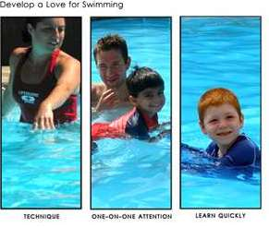
BASIC AQUATIC SKILLS
By learning basic aquatic skills, people gain the skills necessary to float and move around in water
It also help to enable people enter safely and adjust to the water
In an emergency, these skills can save a life
Basic aquatic skills are also the building blocks for learning swimming strokes that are more advanced
Mastering safety skills like floating, changing directions and breath control, is necessary before learning advanced strokes such as breaststroke or front crawl/freestyle

Slide 38
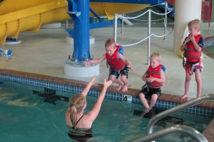
BASIC AQUATIC SKILLS
PHYSICAL AND MENTAL ADJUSTMENT
Anyone entering the water must take time to adapt to the water both mentally and physically
Most aquatic environments are much cooler than bath water. Relatively warm pool water (83⁰ to 63⁰F) may feel cool and cause breathing to quicken
In water up to the neck, the temperature and added pressure of the water around the chest may even make breathing seem strenuous
When breathing speeds up, it becomes hard to relax. Rapid breathing may also increase anxiety in fearful or novice swimmers, making it even more difficult to adjust to water

Slide 39
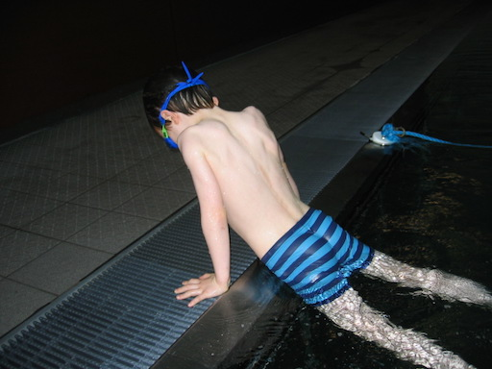
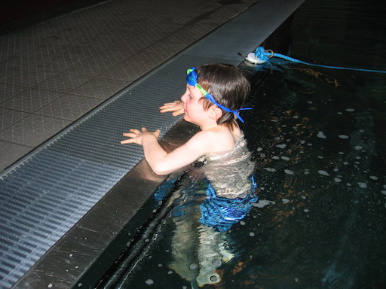
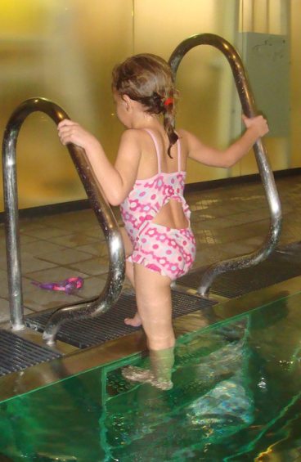
BASIC AQUATIC SKILLS
Physical adjustments to the water involve gradually getting used to the water temperature and the effects of buoyancy
Mental adjustments involve taking efforts to remain relaxed control breathing
Getting wet will help the body get used to the cooler water temperature. This can be accomplished by;
Enter on the steps, ramp or slope until thigh deep and scooping water onto the arms, chest, neck and face
Sitting on the edge of the pool and scooping water onto the body

Slide 40
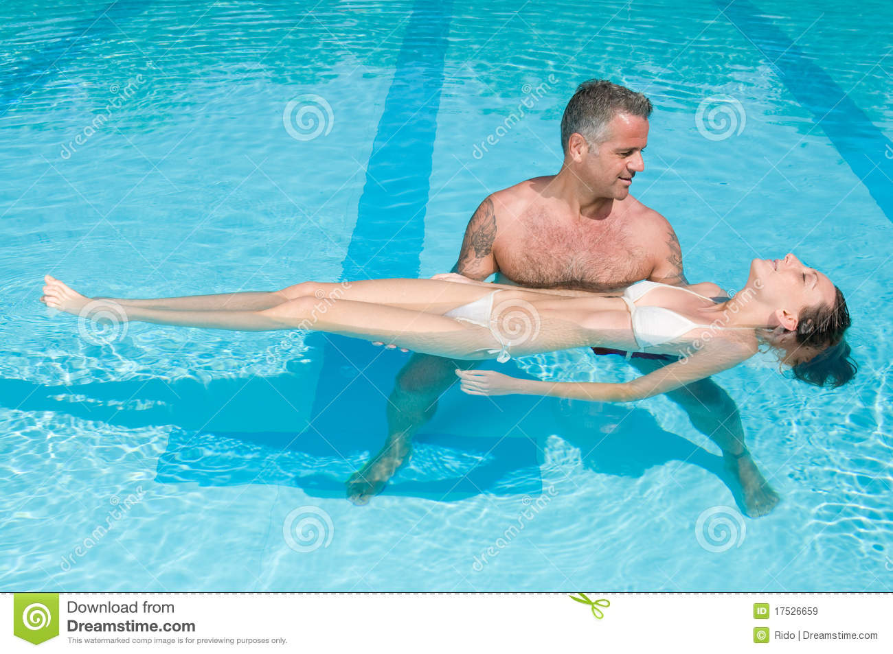
BASIC AQUATIC SKILLS
RELAXATION
Inexperienced swimmers mostly feel afraid around the water/pool and are often apprehensive about entering it.
Relaxation is the key to mentally adjust to an aquatic environment and learning to control breath also helps people to relax
Cold or nervous swimmers should practice breath control before entering the water
Swimmers can practice breath control by;
Breathing in and out slowly and deeply while sitting on the edge of the pool
Taking a deep breath, holding it for a couple of seconds then slowly exhaling

Slide 41
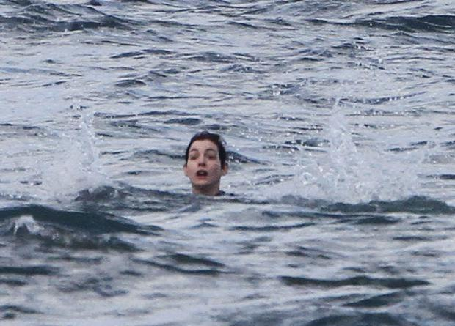
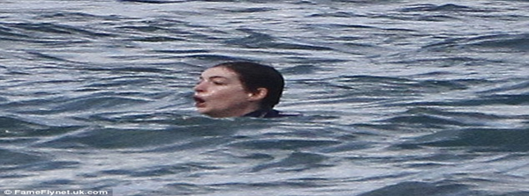
BASIC AQUATIC SKILLS
BOBBING AND BREATH CONTROL
Coordinated breath control is necessary to swim well
Holding the breath for a long time is not necessary but it is important to be able to breathe in and out rhythmically and steadily while swimming
To practice breath control while in the water, try bobbing
To bob;
Hold onto the overflow wall trough or the pool wall in chest deep water
Take a breath
Bend on the knees and fully submerge the head, then strengthen the legs and resurface
While coming up, gently exhale through the mouth and nose

Slide 42
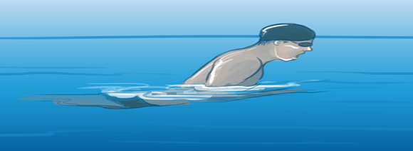
BASIC AQUATIC SKILLS
Inhale when the mouth rises above the surface of the water
Repeat this movement until comfortable
Move to chin-deep water and practice bobbing away from the wall

Slide 43
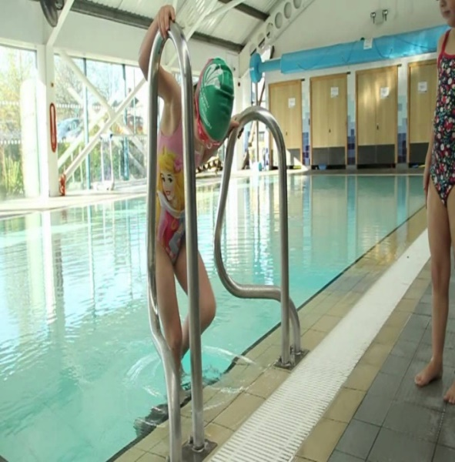
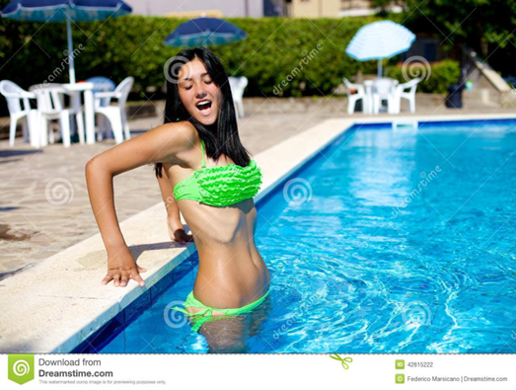
BASIC AQUATIC SKILLS
ENTERING THE WATER
There are several ways to enter a pool/water
The best method to use will depend on the body of water and the surroundings, the size and the ability of the swimmer and the purpose for getting into the water
Beginning swimmers should only enter the pool/water with feet first
In most pools and some other swim areas, this can be done by sitting down, rolling on to the front and sliding into the water or by using the ladder, ramp or stairs

Slide 44
BASIC AQUATIC SKILLS
Swimmers with certain types of disabilities may use a ramp, hoist or lift to enter a pool
At designated ocean, beaches, swimmers should enter the water from shore and shuffle their feet to stir up marine life resting on the bottom to avoid stepping on anything that could cause harm

Slide 45
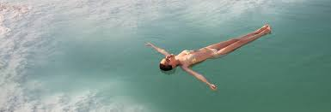
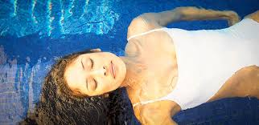
BASIC AQUATIC SKILLS
STAYING AFLOAT
A big part of staying safe in water is feeling confident. Confidence helps prevent panic and allows for clear thinking
Being able to float is a tremendous confidence builder
The ability to stay on the surface of water is also an important safety skill that is especially important for the beginner or nonswimmer
Even though floating is an easy way for many people to stay near the surface, not everyone floats easily
Floating is made easier by physically and mentally adjusting to the water before entering and keeping the body relaxed
Anyone involved in an aquatic can use any of the floating techniques to stay in the surface of the water

Slide 46
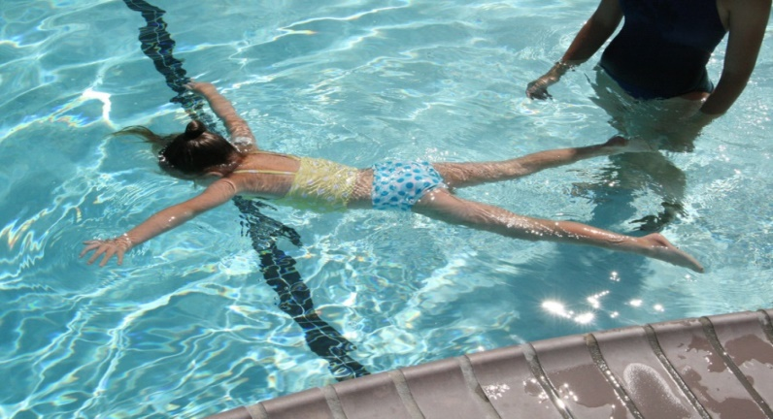
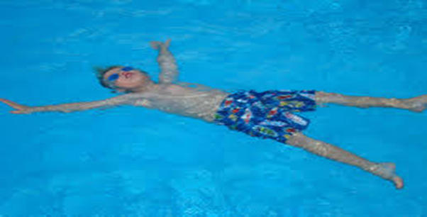
BASIC AQUATIC SKILLS
STAYING AFLOAT; BACK FLOAT
The back or supine float is especially useful for survival
One of the main benefits of the back float is that the mouth stays above water throughout
To float on the back;
In chest deep water, submerge to the neck
Hold the arms overhead and slightly out to the side
Lay the head back until the ears are in the water
Arch the body gently at the hips, pushing the chest and stomach toward the surface
Keep the legs relaxed, knees slightly bent and feet beneath the surface
Breath in and out through the mouth every seconds

Slide 47
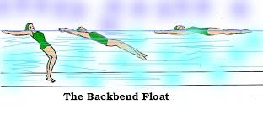
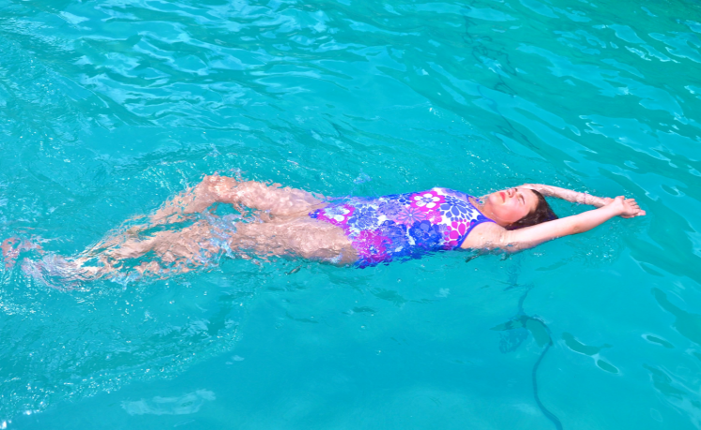
BASIC AQUATIC SKILLS
Swimmers whose natural floating position is diagonal or nearly vertical may need to change position slightly
Swimmers having trouble floating motionless can use sculling or finning motions to help stay near the surface with little effort
To recover to a standing position;
Take a breath, tuck the chin toward the chest and bring the knees forward by bending at the hips
Sweep the arms back, down then forward in a circular motion to bring the body back to vertical, exhale and then stand up
This motion is like pulling up a chair to sit on it

Slide 48
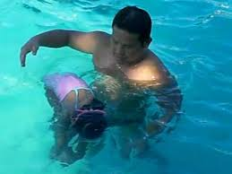
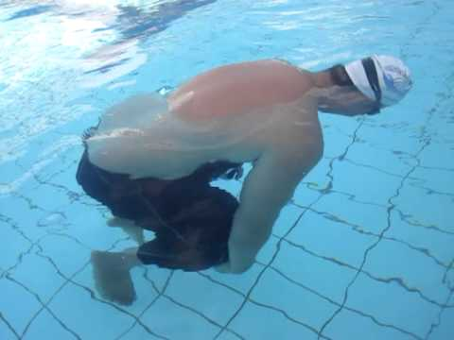
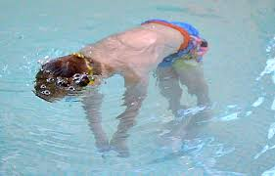
BASIC AQUATIC SKILLS
STAYING AFLOAT; FLOATING ON THE FRONT
There are several ways to float on the front.
Like floating on the back, floating on the front is an important survival skill
Both the survival float and survival swimming involve floating on the front
Jellyfish float
In chest-deep water, submerge on to the neck
Take a deep breath and hold it
Bend forward at the waist and put the head face down in the water

Slide 49
BASIC AQUATIC SKILLS
Flex the knees slightly to raise the feet off the bottom
Let the arms and legs hang naturally from the body
Continue holding the breath and relax as much as possible
Allow the back to rise to the surface of the water
To recover drop the feet, exhale slowly and stand up

Slide 50
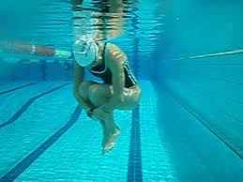
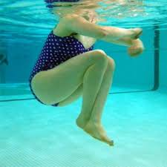
BASIC AQUATIC SKILLS
Tuck float
The tuck or turtle float is similar to the jellyfish float.
Sinking a few inches is possible before getting into the final position
Use the tuck float to check buoyancy
In chest-deep float, submerge to the neck, take a deep breath and hold it
Bend forward at the waist and put the head face down in the water with the chin on the chest
Flex the hips and bring the knees to the chest
Hold on the legs at the mid-calf
Continue holding the breath and relax as much as possible
Allow the body to rise to the surface
To recover, let go of the legs , exhale slowly and stand up

Slide 51
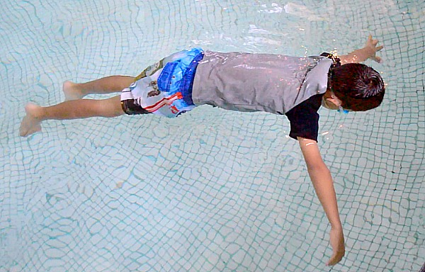

BASIC AQUATIC SKILLS
Front float
The front or prone float helps beginning swimmers become more comfortable in a horizontal position
It is easier to learn this skill in water that is shallow enough to reach the bottom surface with the hands
However it may be difficult for some swimmers to keep their toes off the bottom in this situation because the water is not deep enough for the body to rotate into its natural floating position
Learn the front float in shallow water
Start by lying face down with the hands on the bottom surface

Slide 52
BASIC AQUATIC SKILLS
Take a breath and then put the face in the water until the ears are covered
Slowly lift the hands off the bottom
Relax and extend the arms in the water above
Gently blow out some air through the nose to keep the nose from filling water
If the toes are still on the bottom, relax the legs and gently push up off the bottom to get the toes to rise
Recover, exhale slowly, lift the head and press down with arms, pull the knees under the body toward the chest and place the feet on the bottom then stand up

Slide 53
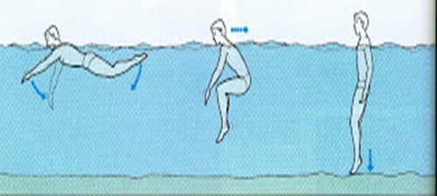
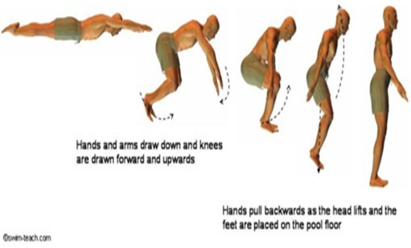
BASIC AQUATIC SKILLS
Learn the front float in chest deep water
Start by submerging to the neck in chest deep water with the arms extended and the palms facing down
Take a breath then lean forward and put the face in the water until the ears are covered
Gently push off the bottom and let the feet and legs float to the surface
Relax and extend the arms in the water above the head
To keep the nose from filling with water, gently blow out some air through the nose

Slide 54
BASIC AQUATIC SKILLS
If the toes are still on the bottom, relax the legs and gently push up off the bottom to get the toes to rise
To recover, exhale slowly, lift the head, press down with arms, pull the knees under the body toward the chest and place the feet on the bottom to stand up

Slide 55
BASIC AQUATIC SKILLS
BASIC MOVEMENT IN THE WATER
Basic movements in the water includes gliding, finning, sculling and treading water.
Learning the skills gives swimmers the ability to move efficiently through water
Finning and sculling are the basic skills necessary for creating movement or staying in position
Swimmers who are able to tread water can remain in place with their head above water
Gliding, finning, sculling and treading are essential survival skills
Swimmers can use these skills to move through the water with direction and reach safety in an emergency

Slide 56
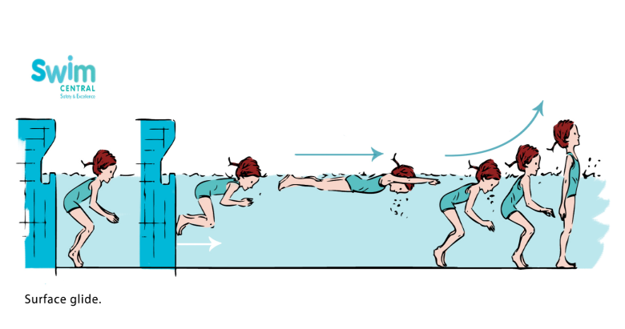
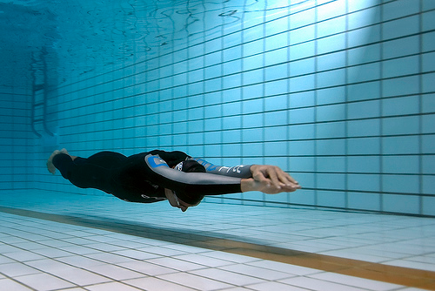
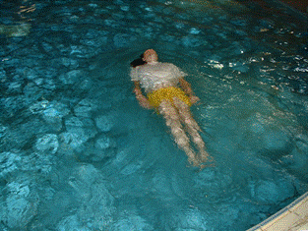
BASIC AQUATIC SKILLS
BASIC MOVEMENT IN THE WATER; GLIDING
Gliding involves moving through the water in a horizontal position
a streamlined position
The position places the body in a narrow sharp form drag
Front glide
Begin in the front float position and push off the side or bottom with the feet to move forward in a streamline position
Glide until momentum slows to swimming speed and then start swimming

Slide 57
BASIC AQUATIC SKILLS
Back glide
Begin in the back float position and push off the side or bottom with the feet to move forward in a streamlined position
Glide until momentum slows to swimming speed and then start swimming

Slide 58
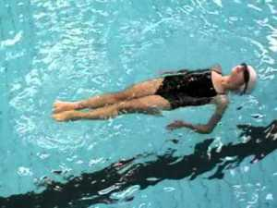
BASIC AQUATIC SKILLS
BASIC MOVEMENT IN THE WATER; FINNING
Finning is a way to move through the water using a pushing motion with the arms.
This technique can also be used to help stay at the surface of the water while floating on the back
Move into a back float position with the head back and arms at the side. The hands are relaxed under the surface of the water with the palms facing the bottom of the pool
Bend the elbows and slowly move the hands out from the side
Flex the wrists and push the water with the palms toward the feet in a short stroke. Arm movements may be simultaneous or slightly alternating

Slide 59
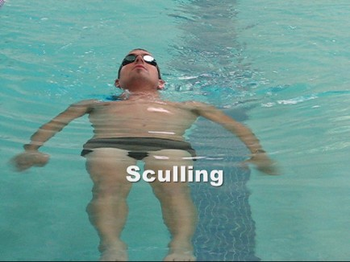
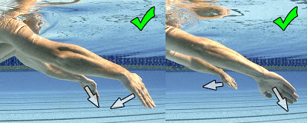
BASIC AQUATIC SKILLS
BASIC MOVEMENT IN THE WATER; SCULLING
Sculling refers to movements of the arms and hands that manipulate the flow of water.
These movements create a force perpendicular to the direction of motion resulting in lift
The lift generated through sculling allow as a person to move forward, backward or remain in place floating or treading the water
Sculling is an important skill for survival
This technique can help a swimmer keep the mouth above the water while resting or moving toward safety

Slide 60
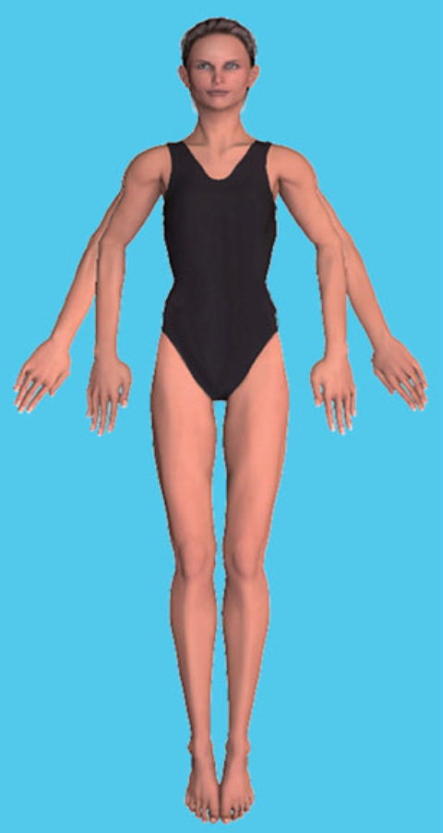
BASIC AQUATIC SKILLS
In sculling, as in swimming, the swimmer tries to establish “grab” or “catch” on the water.
“Grab” or “catch” on the water can be described as a feeling of pressure on the hands and forearms that gives the swimmer the ability to press the torso away from the hands, going up, down or across the surface.
Some swimmers also describe “grab” or “catch” as a feeling of controlling the water in the palm of the hand, as if holding a small ball in the palm, pushing it out and catching it before it gets away, and then pressing it in toward the torso and again catching it.

Slide 61
BASIC AQUATIC SKILLS
Once a swimmer gets “grab” or “catch,” the hands will automatically move through the figure-eight path.
Too much tension in your hands and arms may prevent you from establishing catch on the water and cause you to slice your hands in and out through the water, eliminating the figure-eight path and limiting the force or propulsion generated.
Your palms should rotate between 20 and 50 degrees to get the most efficient and effective sculls.

Slide 62
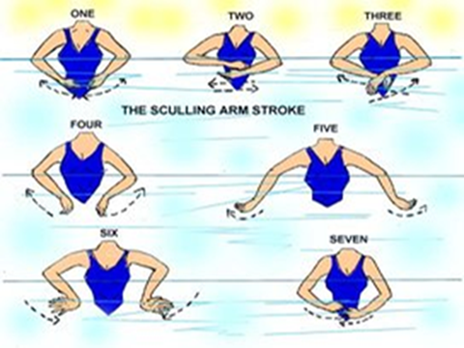
BASIC AQUATIC SKILLS
Sculling is also a fundamental skill used in swimming strokes, in water polo, and in synchronized swimming
To practice the sculling motion;
Hold the hands just below the surface while standing in waist deep water
Keep the palms flat, facing downward and rapidly move them side to side to create whirlpools
While holding the elbows about a tennis ball’s distance from the ribs, move the forearms out and back in
Keep your upper arms still while the lower arms and hands maintain consistent water pressure

Slide 63


BASIC AQUATIC SKILLS
-
BASIC MOVEMENT IN THE WATER; TREADING
Treading water is an important personal safety skill that allows swimmers to remain upright in deep water with head out of the water
Treading water typically involves a scissors, breaststroke or rotary kick along with sculling or finning movements of the hands and arms
The combination of these movements allow the swimmer to remain in place with the head above water
However, treading water is a versatile technique

Slide 64
BASIC AQUATIC SKILLS
-
To tread water using the breaststroke or scissors kick;
Stay nearly vertical, with the upper body bent slightly forward at the waist and the legs separated
Make continuous sculling movement with the hands a few inches below the surface in front of the body, with the palms facing downwards and elbows bent. Make sculling movements with a much wider reach than used to hold position during a back float
Kick with just enough thrust to keep the head above water

Slide 65


BASIC AQUATIC SKILLS
-
The rotary or eggbeater kick is another effective kick for treading water
Because it has no resting phase, this kick provides continuous support.
It is normally used in water polo, synchronized swimming and lifeguarding
To tread water with the rotary kick;
Stay nearly vertical, with the upper body bent slightly forward at the waist, making the same sculling movements with the arms
Keep the back straight and the hips flexed so that the thighs are comfortably forward

Slide 66
BASIC AQUATIC SKILLS
-
Pull up the lower legs so that they are at an angle of nearly 90 degrees to the thigh and the knees are slightly wider than hip width
Rotate the lower legs at the knees, one leg at a time, making large circular movements with the foot and lower leg. One leg moves clockwise and the other anticlockwise
As each foot moves sideways and forward, extend it sharply outward. The power of the kick comes from lift forces created by the inward sweeping action of the foot
As one leg kicks, the other leg recovers to kick immediately after the first kick. Kick just hard enough to keep the head out of water

Slide 67
STARTING, CHANGING DIRECTION AND TURNING OVER
Starting
You can start swimming by moving from a vertical to a horizontal position, or by pushing off from the pool wall.
To move from a vertical to a horizontal position on your front:
1. Take a breath.
2. Lean forward and put your face in the water until your ears are covered.
3. Extend your arms in front of you, in the direction you intend to go.
4. Push off the bottom or kick your legs to help move your body into a horizontal position, and then start swimming.

Slide 68


STARTING, CHANGING DIRECTION AND TURNING OVER
To move from a vertical to a horizontal position on your back:
Move your arms overhead and slightly out to the side.
Lay your head back until your ears are covered.
Arch your body gently at the hips, pushing your chest and stomach toward the surface.
Push off the bottom or kick your legs to help move your body into a horizontal position, and then start swimming.
Starting from the Pool Wall
To push off from the pool wall on your front:

Slide 69
STARTING, CHANGING DIRECTION AND TURNING OVER
Grasp the overflow trough or the pool wall with one hand.
Extend your other arm in front of you, in the direction you intend to go. Rotate your body and lean forward slightly, so that your shoulder and extended arm are under the surface.
Place your feet against the pool wall, about hip-width apart with one foot higher than the other
Take a breath, put your face in the water and let go of the wall and rotate your body into a face-down position.
Extend your arms into a streamlined position and push off the wall with both feet. Keep your legs together and your toes pointed.
Glide until your momentum slows down

Slide 70
WATER SAFETY – RECOGNITION AND RESPONSE
Anyone who participates in aquatic activities should know how to recognize and respond to an aquatic emergency.
Learning basic skills for self rescue and for helping someone who is in trouble in the water is important for everybody, because most people work or play near water.
In fact, knowing how to respond to an emergency is just as important as how to prevent one.
By focusing on the steps necessary for recognizing and responding to an aquatic emergency as well as tips and procedures for self rescue, this course outlined the information necessary to handle most aquatic emergencies

Slide 71
WATER SAFETY – RECOGNITION AND RESPONSE - EMERGENCY ACTION PLANS
In the excitement of an emergency, it is easy to become frightened or confused about what to do.
Remember to stay calm – you can help. In any emergency situation, follow the three action steps;
Check – check the scene and the victim. Check the scene for unsafe conditions that would prevent you from helping
Call – call the local emergency number
Care – care for the victim. Care for the conditions found and make the victim comfortable until emergency medical services (EMS) personnel arrive and take over

Slide 72
WATER SAFETY – RECOGNITION AND RESPONSE - PREPARING FOR EMERGENCIES
While in a pool or around, you need to be prepared to respond should an emergency arise.
There are three simple things you can do to prepare for an emergency.
First, learn first aid and CPR.
Second, stock your pool area with a telephone, emergency contact information and basic water rescue equipment, including:
Reaching equipment (such as a reaching pole or shepherd’s crook) that can be used to pull a person to safety.
Throwing equipment (such as a ring buoy, heaving jug or throw bag) that can be thrown to a person who is in trouble so that he or she can be pulled to safety.

Slide 73



WATER SAFETY – RECOGNITION AND RESPONSE - PREPARING FOR EMERGENCIES
Thirdly, make a safety post to keep basic water rescue equipment organized and accessible
A safety post can be used to keep basic water rescue equipment organized and easily accessible poolside.
To make a safety post, you will need:
4 inch × 4 inch post, 6 feet long
Screw-in hanging hook large enough to hold the throwing equipment
Throwing equipment, such as a ring buoy or a heaving jug*

Slide 74
WATER SAFETY – RECOGNITION AND RESPONSE - PREPARING FOR EMERGENCIES
Reaching equipment, such as a 10- to 12-foot reaching pole
Clips to secure the reaching equipment OR two 6-ounce cans with both ends removed and nails
Plastic zipper bag
First aid kit
Emergency contact information, including phone numbers for summoning help and information that will help responders find your location (i.e., the street address and the names of the nearest cross streets)
Safety poster or first aid booklet (optional)

Slide 75
WATER SAFETY – STAYING SAFE WHILE IN WATER
Specific activities that are enjoyed in, on or around the water have specifi c safety considerations.
Swimming
To stay safe while swimming, never swim alone and always swim in a supervised area. In addition, be aware of situations and behaviors that could threaten your safety while swimming.
Exhaustion
Becoming too tired while swimming can put a person at risk for drowning. Exhaustion (also referred to as fatigue) simply means that the person no longer has the energy to keep swimming or floating.

Slide 76
WATER SAFETY – STAYING SAFE WHILE IN WATER
Exhaustion can occur as a reaction to cold water, after being in the sun for too long, as a result of being dehydrated, as a result of swimming too long or too hard, or from any combination of these factors.
It is more likely to occur in swimmers who:
Swim early in the season when the water is cold.
Swim too much before they are really in shape.
Do not know which strokes to use to conserve energy (for example, the elementary backstroke takes relatively little energy compared to a front crawl).
Are young, inexperienced or both.

Slide 77
WATER SAFETY – STAYING SAFE WHILE IN WATER
To prevent exhaustion, take breaks and rest often while swimming or doing other water activities. Be aware of your abilities and environment, and listen to your body.
A swimmer may be acting oddly or a scream or sudden splash may be heard. Sometimes unusual odor such as strong chlorine odor could indicate a problem
Being able to recognize a person who is having trouble in the water may help save that person’s life.
Most people who are in trouble in the water cannot or do not call for help. They spend their energy just trying to keep their heads above water to get a breath
A person who is experiencing a medical or other type of emergency might slip underwater quickly or never resurface

Slide 78
WATER SAFETY – RECOGNITION AND RESPONSE - RECOGNIZING AN EMERGENCY
There are two types of drowning victims;
An active drowning victim is in vertical position but unable to move forward or tread water.
Normally an active drowning victim will try to press down with the arms at the side in an instinctive attempt to keep the head above the water
A passive drowning victim is not moving and will be floating face-down on the bottom or near the surface of water

Slide 79
WATER SAFETY – RECOGNITION AND RESPONSE - RECOGNIZING AN EMERGENCY
A swimmer in distress may be too tired to get to shore, the side of the pool or a boat, but is still afloat and able to breathe.
A distress swimmer may be calling for help and/or floating, treading water or clinging to a line for support.
someone who is trying to swim but making little or no progress may be in distress and if not helped, the swimmer may soon become a drowning victim.

Slide 80
WATER SAFETY – RECOGNITION AND RESPONSE - DECIDING TO ACT
Once you recognize an emergency has occurred, the next step is to decide to act and how to act
Often people are slow to act in an emergency because they are not sure exactly what to do or they think someone else will act.
If you are in an emergency situation, your decision to act may save someone’s life.
Once you have decided to act, proceed safely. Make sure the scene is safe-do not go rushing into dangerous situation and become a victim yourself.

Slide 81
WATER SAFETY – RECOGNITION AND RESPONSE - DECIDING TO ACT
If the victim is in the water, first decide whether he/she needs help getting out of the water then act based on your training. Never enter the water to help a victim unless you are trained to do so.
The first goal is for the responder to stay safe. If it can be done safely, the next step is to get the victim out of the water.
If the victim is out of the water, quickly try to determine what help the victim needs and check for any dangers to yourself or others helping.

Slide 82
WATER SAFETY – RECOGNITION AND RESPONSE - DECIDING TO ACT
Look for any other victim. Look for bystanders who can help to give first aid or call for help. If the victim is in water, remember that the first goal is for the responder to stay safe. If it can be done safely, the next step is to help get the victim out of water

Slide 83
WATER SAFETY – RECOGNITION AND RESPONSE - CALLING FOR HELP
If the victim is unconscious, send someone else or call EMS personnel and care for the victim. If the victim is conscious, first try to safely get the victim out of the water and then determine the help and care needed.
If the victim is not in the water and there is an emergency, call EMS personnel immediately. If in doubt about whether the victim needs professional help, do not hesitate – call EMS personnel. You can also ask someone to call if there are bystanders around. Tell the caller(s) to report back what the dispatcher said

Slide 84
WATER SAFETY – RECOGNITION AND RESPONSE - CALLING FOR HELP
The following conditions and situations are serious and require a call to EMS personnel;
Any drowning or nonfatal submersion (near drowning) situation
Injury to the head, neck or back
Trouble breathing
Persistent chest or abdominal pain or pressure
Unconsciousness
Severe bleeding, vomiting blood or passing blood
Seizure, severe headache or slurred speech
Poisoning
Possible broken bones
Multiple injuries

Slide 85
WATER SAFETY – RECOGNITION AND RESPONSE - COMPARING BEHAVIORS OF DISTRESSED, ACTIVE AND PASSIVE SWIMMERS
BEHAVIORS | SWIMMER | DISTRESSED SWIMMER | ACTIVE DROWNING SWIMMER | PASSIVE DROWNING SWIMMER
Breathing | Rhythmic breathing | Can continue breathing and may call for help | Struggles to breathe; cannot call out for help | Not breathing
Arm and leg action | Relatively coordinated | Floating, sculling or treading water; may wave for help | Arms to sides alternately moving up and pressing down; not supporting kick | None
Body position | horizontal | Horizontal or diagonal, depending on means of support | vertical | Horizontal or vertical face-down, face-up or submerged
locomotion | recognizable | Little or no forward progress; less and less able to support self | None; has only 20-60 seconds before submerging | none

Slide 86
WATER SAFETY – RECOGNITION AND RESPONSE - EMERGENCY ACTION PLANS
Emergency action plans are detailed plans that describe how everyone should act in an emergency
An emergency action plan should be established for any body of water or near the home such as pool, pond or canal
Only swim in supervised areas where emergency action plans have been established. If there is an emergency, follow the lifeguard’s instructions.
To create an emergency action plan;
Identify types of emergencies that could occur such as someone falling into the pool or other body of water.

Slide 87
WATER SAFETY – RECOGNITION AND RESPONSE - EMERGENCY ACTION PLANS
Identify rescue equipment available such as a nearby telephone, ring buoy with a line attached and reaching a pole
Create an emergency contact list that include telephone numbers for EMS personnel and names the nearest cross streets to the home

Slide 88
WATER SAFETY – RECOGNITION AND RESPONSE - EMERGENCY ACTION PLANS
The basic elements of an emergency action plan include the following;
An emergency signal.
Blow a whistle or horn or wave a flag to alert swimmers that they should leave the water immediately.
At a home pool or other body of water near the home, the signal will tell family members and neighbors that there is an emergency and help is needed quickly.
Safety equipment.
For the home pool or other body of water near the home, safety equipment includes a telephone and rescue equipment.
Keep all safety equipment near the water. Make a safety post for the emergency equipment and set it close to the water.
The safety post should have a throwing or other devices such as a reaching pole for assists, along with a well stocked first aid kit

Slide 89
WATER SAFETY – RECOGNITION AND RESPONSE - EMERGENCY ACTION PLANS
Emergency procedures. Develop and post procedures for what to do in a water emergency.
Emergency procedures must be carefully planned and should outline;
Steps a responder should take to remove the victim from danger, without putting the responder in danger
Who is responsible for calling the EMS personnel and how and when the call is made. Remember to take the use of mobile phones into accounts
How EMS personnel are directed to the specific scene of the emergency. For example appoint someone to meet the EMS personnel at the street
Who should be contacted such as the victim’s immediate family members and health care provider.

Slide 90
WATER SAFETY – RECOGNITION AND RESPONSE - RESPONDING TO AN EMERGENCY
DROWNING
Drowning is a major but under-recognized public health problem in the developing world, and leading cause of death in many countries
Drowning occurs when a person is unable to breathe because their head is submerged in water
The brain cannot survive for long without oxygen and after short time, a person will become unconscious. If the brain continues to lack oxygen then it will die in just minutes. A lack of oxygen in the lungs may also stop the heart from working.

Slide 91
WATER SAFETY – RECOGNITION AND RESPONSE - RESPONDING TO AN EMERGENCY
More than half the drownings in swimming pools, for example, involve unsupervised small children.
About one-third of drowning victims are experienced swimmers who become overconfident and swim too far from shore.
Almost all drownings among boaters result from ignoring such basic safety rules as wearing a life preserver and staying with an overturned boat.

Slide 92
WATER SAFETY – RECOGNITION AND RESPONSE - RESPONDING TO AN EMERGENCY
CONDUCTING A RESCUE
It is important to let someone know you are conducting a rescue. They can then provide appropriate assistance with the rescue or go for further help if necessary
To signal that you are taking emergency action, shout for help or blow a whistle 3 times
Rescuing a drowning casualty is dangerous and many people drown each year while trying to help someone else in the water
Conducting a rescue from land is the safest type of rescue as it does not require entry into the water or direct contact with a drowning casualty

Slide 93
WATER SAFETY – RECOGNITION AND RESPONSE - RESPONDING TO AN EMERGENCY
TYPES OF RESCUE
Land base rescue
When: when the casualty is close to shore or side of the pool
Why: it is the safest type of rescue
How: Reach the casualty using a long rigid object such as stick or pole.
    Stay low on the ground so that the casualty cannot pull you into the water
    Pull the casualty into the side

Slide 94
WATER SAFETY – RECOGNITION AND RESPONSE - RESPONDING TO AN EMERGENCY
Throw rescue
When: if the casualty is close to shore but too far to conduct a reach rescue
Why: reduces the risk to the rescuer – no need to swim
How: Attract the attention of the casualty
Throw a floating object to the casualty such as a rope, water container or rescue tube
Tell the casualty to kick legs their legs and swim in to the side
Help the casualty out of the water

Slide 95
WATER SAFETY – RECOGNITION AND RESPONSE - RESPONDING TO AN EMERGENCY
Wade rescue
When: if the casualty is close to shore and in shallow water. The casualty may have stepped into a hole
Why: reduces risk to rescuer – no need to swim. Does not require a floating object
How: Attract the attention of the casualty
Enter the water carefully, taking a stick/pole with you if possible to test water depth and for the casualty to hold into
Pass one end of the stick/pole to the casualty
Help the casualty out of the water

Slide 96
WATER SAFETY – RECOGNITION AND RESPONSE - RESPONDING TO AN EMERGENCY
SWIMMING RESUE
Rescues that require someone/lifeguard to swim are more dangerous than rescues from the land because;
Of the dangers of the water
Those being rescued may panic and grab the rescuer
A swimming rescue should only be attempted if there is no option of a land based rescue

Slide 97
WATER SAFETY – RECOGNITION AND RESPONSE - RESPONDING TO AN EMERGENCY
Where possible, buoyant rescue equipment should be used to assist with the rescue of a conscious casualty
However if rescue equipment is not available – or the casualty is unconscious – then the lifeguard/rescuer must do a contact tow to bring the casualty back to shore

Slide 98
WATER SAFETY – RECOGNITION AND RESPONSE - RESPONDING TO AN EMERGENCY
  ENTERING THE WATER
  Determine the location of the casualty before entering the water
  Choose the shortest and safest route to the casualty. This may involve moving along the beach before entering the water to take into account local currents
  If the depth of water is unknown – or there may be submerged objects- then run or wade up to chest depth before starting to swim
  If the depth is known then a shallow dive can be used

Slide 99
WATER SAFETY – RECOGNITION AND RESPONSE - RESPONDING TO AN EMERGENCY
  SWIMMING TO A CASUALTY
  When swimming to a casualty, the rescuer should swim on their front, regularly bringing their head out of the water to observe the position of the casualty
  The rescuer must communicate with the casualty so that they know help is coming

Slide 100
WATER SAFETY – RECOGNITION AND RESPONSE - RESPONDING TO AN EMERGENCY
APPROACHING A CONSCIOUS CASUALTY
A distressed casualty may try to grasp the rescuer if they get too close. When arriving at the scene the rescuer should keep a safe distance away from the casualty (preferably 3 meters) while they assess the situation
If the rescuer has a buoyant rescue aid then this should be thrown to the casualty while maintaining a safe distance
If the rescuer has no rescue aid then they must get into a position where they can avoid the grasp of the casualty, pull them into horizontal position and prepare for the tow back to shore
This is best achieved by the rescuer swimming behind the casualty and providing words of reassurance to calm them down and instructions on what actions they should take to help the rescuer tow them to shore

Slide 101
WATER SAFETY – RECOGNITION AND RESPONSE - RESPONDING TO AN EMERGENCY
APPROACHING AN UNCONSCIOUS CASUALTY
If the casualty is unconscious thy need to be rolled quickly onto the back to keep their face and mouth out of the water and maintain breathing
This is done by simply putting down on one shoulder and up on another

Slide 102
WATER SAFETY – RECOGNITION AND RESPONSE - RESPONDING TO AN EMERGENCY
TOWING CASUALTY BACK TO SHORE
When towing a casualty back to shore, the rescuer will only have one arm close to the surface. Normal swimming techniques will not work so rescuer must learn swimming stroke that allows them to swim effectively while towing the casualty
The most effective way is for the rescuer to swim using sidestrokes – on their side with their hip facing the sky. The legs are kept slightly bent and kicked in a scissor action

Slide 103
TIPS FOR REDUCING THE RISK FOR DROWNING IN CHILDREN
Enroll children in Red Cross Parent and Child Aquatics, Preschool Aquatics and Learn-to-Swim courses. Providing early aquatic experiences to a child is a gift that will have lifelong rewards.
Young children are curious and their interests and abilities change from day to day. Do not leave a young child unattended near any source of water, even for a moment.
Closely supervise children in, on or around the water, even when a lifeguard is present, no matter how well the child can swim or how shallow the water.

Slide 104
TIPS FOR REDUCING THE RISK FOR DROWNING IN CHILDREN
Stay within an arm’s reach of any weak or inexperienced Swimmer who is in the water.
Know each child’s swimming ability and set specific rules for each child based on her swimming ability.
Do not rely on the use of water wings, swim rings, inflatable toys and other items designed for water recreation to replace a U.S. Coast Guard-approved life jacket or adult supervision. These devices can suddenly shift position, lose air or slip out from underneath the child, putting the child at risk for drowning. They may also falsely increase a child’s sense of confidence, causing him to venture into water that is too deep.

Slide 105
TIPS FOR REDUCING THE RISK FOR DROWNING IN CHILDREN
Teach children not to engage in competitive underwater games, such as seeing who can hold his or her breath the longest underwater or seeing who can swim the farthest before coming up for air.
Hyperventilation (that is, taking a series of rapid, deep breaths before submerging in an effort to hold the breath longer underwater) affects the body’s drive to breathe.
The child could pass out and then instinctively take a breath underwater, leading to drowning.
Teach children to stay away from pool drains and other openings that create suction. The suction can hold the child underwater, leading to drowning.

Slide 106
TIPS FOR REDUCING THE RISK FOR DROWNING IN CHILDREN
Prevent access to standing water in the home. Empty bathtubs, sinks, kiddie pools, buckets and other containers immediately after use. Keep toilet lids down and bathroom and laundry room doors closed and secured with safety locks.
Never leave a child in a bathtub alone; always stay within arm’s reach. Do not rely on bathtub floating aids to protect your child from drowning.
If you own an in ground swimming pool, aboveground swimming pool (including inflatable “easy-set”-type pools) or hot tub:

Slide 107
TIPS FOR REDUCING THE RISK FOR DROWNING IN CHILDREN
Surround the entire pool or hot tub area with a fence that is at least 4 feet high, has a self-closing and self-latching gate, and is designed so that a child cannot climb over, under or through it.
Be sure that all gates, windows and doors leading to the pool or hot tub area are locked.
Make sure that pools and hot tubs are covered when not in use, and that the cover is secured.
Keep pool toys out of the water and out of sight. (A child may see a pool toy floating in the water and try to go after it.)
To prevent the child from climbing over a fence and getting into the pool or hot tub area, keep chairs, tables and other items the child could climb on away from the pool or hot tub enclosure.

Slide 108
TIPS FOR REDUCING THE RISK FOR DROWNING IN CHILDREN
If a child is missing, always look in the pool area first. Seconds count in preventing death or disability.
If there are bodies of water, fountains or other water features on or near your property or in the community, teach children that these areas are off-limits unless they are accompanied by an adult.
When visiting another home, check the site for potential water hazards and always supervise your children.
Never let a child play near storm drains. (Storm drains are especially dangerous after it has rained.)

